Slide 1
Introduction to Spatial Data Science and Machine Learning Urban Design B-Pro 2022/2023 Liam Thomas Bolton PhD Architectural Space and Computation student and PGTA

Slide 2
Overview
The aim of the workshops is to provide an introduction to spatial data science and machine learning with Python:
Python programming for spatial data science
Spatial data, formatting
Data vis and mapping
Machine learning

Slide 3
Workshop Resources
The workshop material – including presentation slides, data and notebooks – has been uploaded to Github:
https://github.com/lbuk/UD_Intro_SDSML2022

Slide 4
Schedule
01. Spatial Data - November 11th 2022
02. Visualisation - November 18th 2022
Modelling - November 25th 2022 - CANCELLED (UCU STRIKES)
03. Machine Learning - December 2nd 2022
Intro to machine learning: concepts, methods and ethics
Python for machine learning

Slide 5
03. Machine Learning 03_machine_learning - data - notebook

Slide 6
What is Machine Learning? Machine learning is a form of artificial intelligence (AI) in which algorithms learn and make predictions from data. In spatial data science, machine learning has been utilised to analyse and model land use, the living environment and the urban environment.

Slide 7
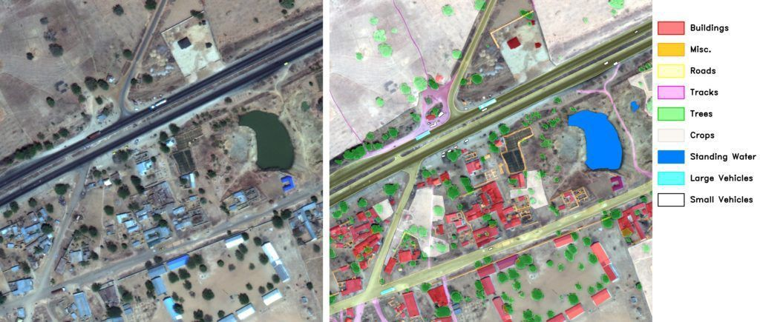
Land Use Mapping
Rayan Potter, https://medium.com/nerd-for-tech/what-are-the-ai-applications-for-satellite-imagery-in-machine-learning-3495b2abe514

Slide 8
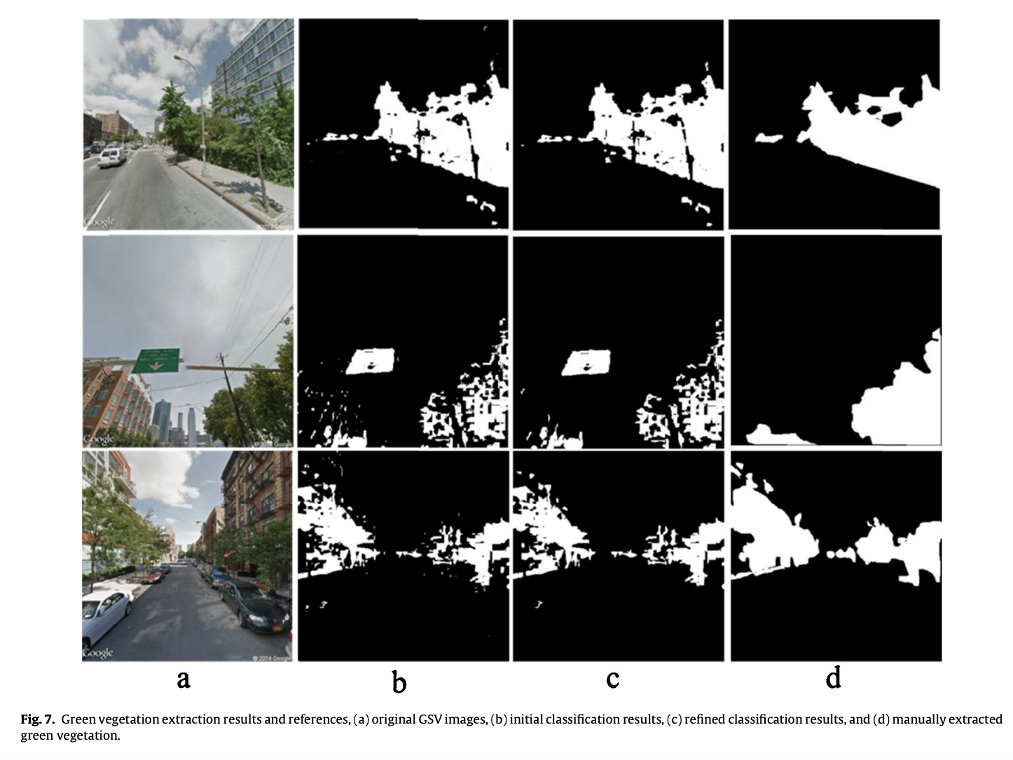
Environmental Measurement
Treepedia, https://senseable.mit.edu/treepedia/treepedia_publication.pdf

Slide 9
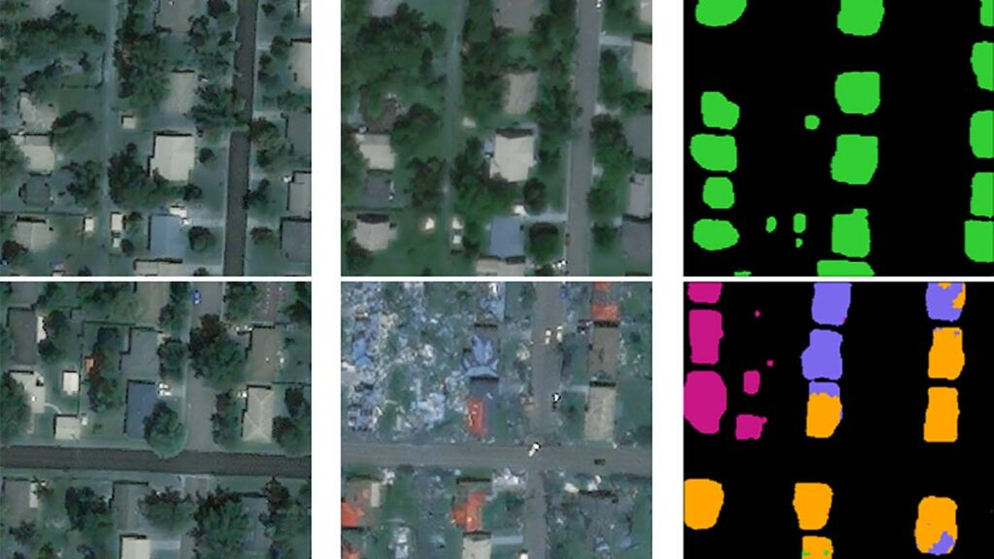
Urban Assessment
Microsoft, https://www.microsoft.com/en-us/research/project/geospatial-machine-learning/

Slide 10
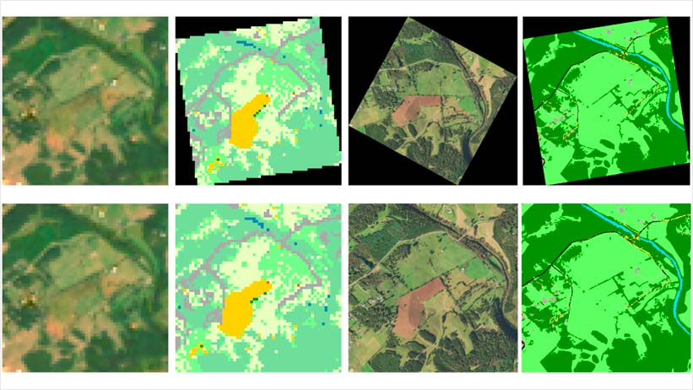
Spatial Data for Machine Learning
Sources of machine learning data in a spatial context can include:
- Satellites
- Google Street View
- Drones
Microsoft, https://www.microsoft.com/en-us/research/project/geospatial-machine-learning/

Slide 11
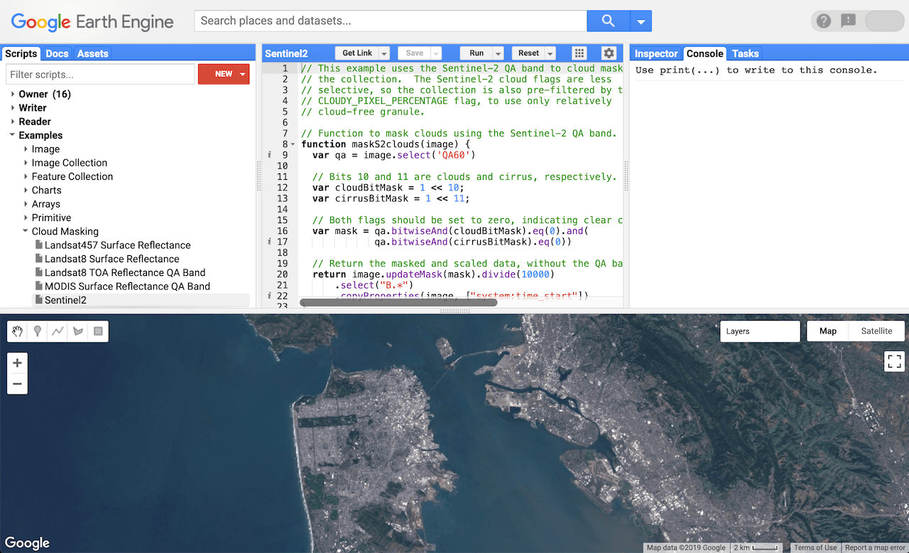
Google Earth Engine
“a cloud-based geospatial analysis platform that enables users to visualise and analyse satellite images of our planet”.
Google Earth Engine has a number of functions and spatial datasets for performing machine learning.
https://earthengine.google.com/
Google Earth Engine, https://developers.google.com/earth-engine/guides/getstarted

Slide 12
Terminology
A list of some key machine learning terms:
Algorithm
An algorithm is a set of rules that can be utilised to calculate an answer to a question or problem.
Features
The features are the input.
Labels
The labels are what we are aiming to predict.
Independent and dependent variables
The independent variable is what we expect will influence the dependent variable.
Model
The model defines the association between the labels and the features.
Training data
The data utilised to train an algorithm.
Testing data
The data utilised to test an algorithm.
W3Schools, https://www.w3schools.com/ai/ai_ml_terminology.asp

Slide 13
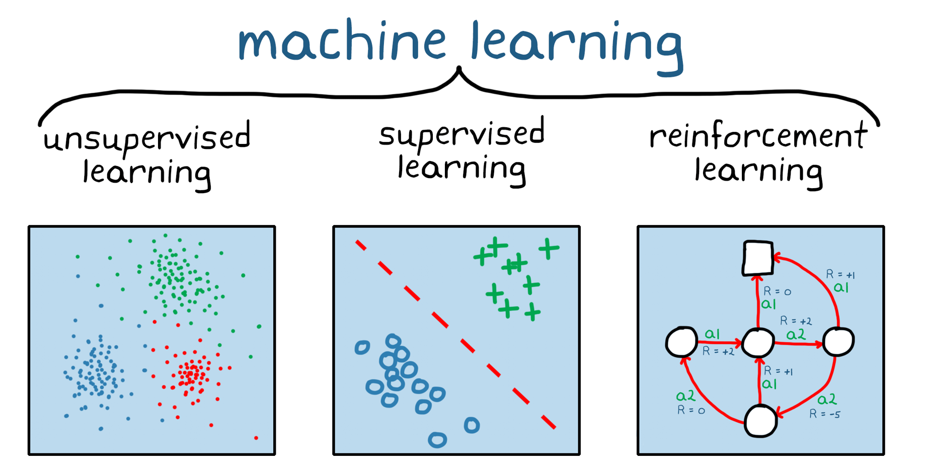
Machine learning techniques can be categorised into supervised learning, unsupervised learning and reinforcement learning.
MathWorks, https://www.mathworks.com/

Slide 14
Supervised Machine Learning
In supervised machine learning, labelled datasets are utilised to train algorithms. Forms of supervised machine learning can include spatial regression and classification.

Slide 15
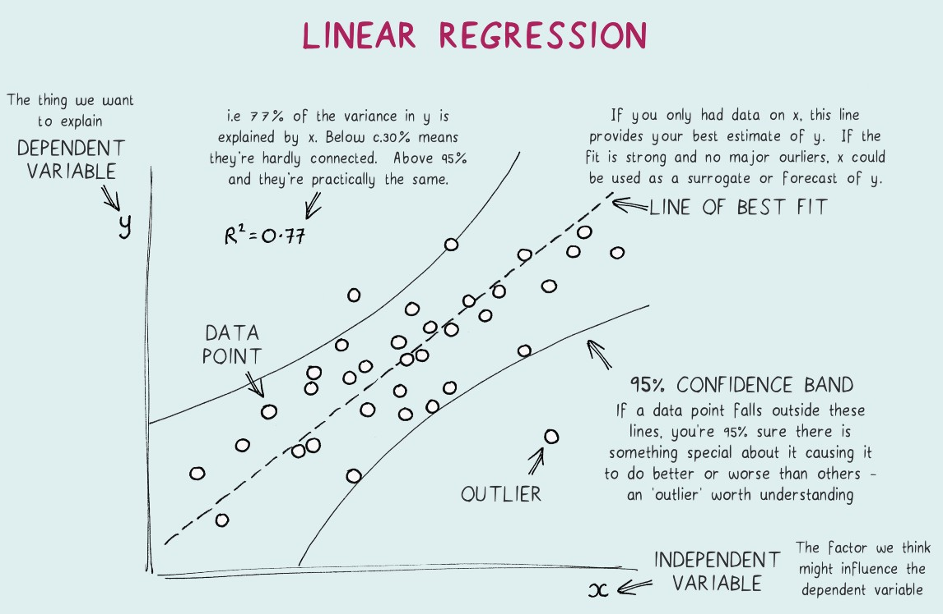
Regression
Definition
Regression estimates how independent variables effect a dependent variable.
The output of linear regression is typically quantitative and continuous. The output of logistic regression is typically qualitative and discrete.
Example
House price analysis.
Towards Data Science, https://towardsdatascience.com/linear-regression-explained-1b36f97b7572

Slide 16

Classification
Definition
Classification categorises data into groups.
The output of classification is typically qualitative and discrete.
Example
Satellite image classification.
simlilearn, https://www.simplilearn.com/regression-vs-classification-in-machine-learning-article

Slide 17
Unsupervised Machine Learning
In unsupervised machine learning, unlabeled datasets are utilised to identify patterns. Forms of unsupervised machine learning can include spatial clustering and dimensionality reduction.

Slide 18
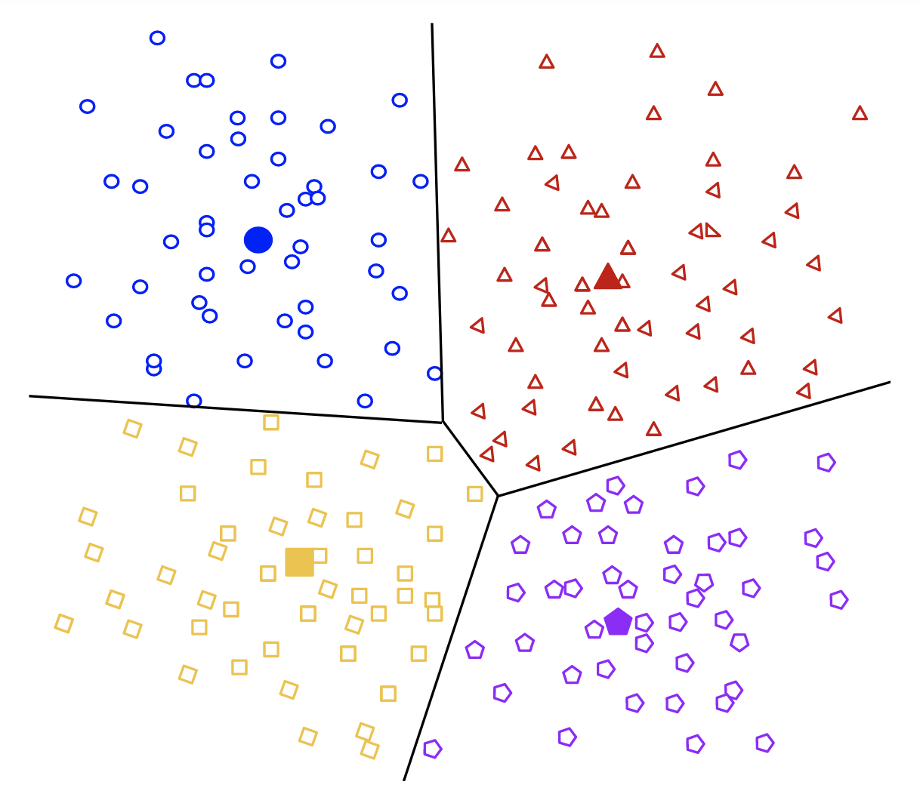
Clustering
Definition
Clustering divides data into clusters.
The output of clustering is typically discrete.
Example
Land use analysis.
Google, https://developers.google.com/machine-learning/clustering/clustering-algorithms

Slide 19
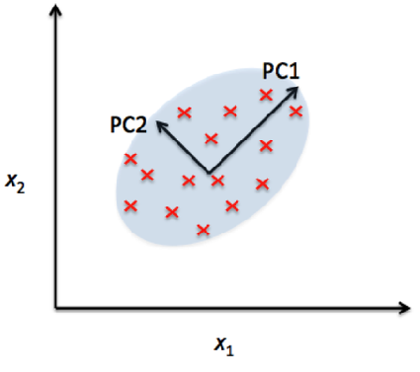
Dimensionality Reduction
Dimensionality reduction transforms data from a high-dimensional space to a low-dimensional space.
The output of dimensionality reduction is typically continuous.
Example
Big data visualisation and 3D mapping.
Towards Data Science, https://towardsdatascience.com/dimensionality-reduction-for-machine-learning-80a46c2ebb7e

Slide 20
Reinforcement Learning
In reinforcement learning, the machine learning algorithm learns through trial and error. Examples of reinforcement learning can include real-time models and big data visualisation.
MathWorks, https://www.mathworks.com/

Slide 21
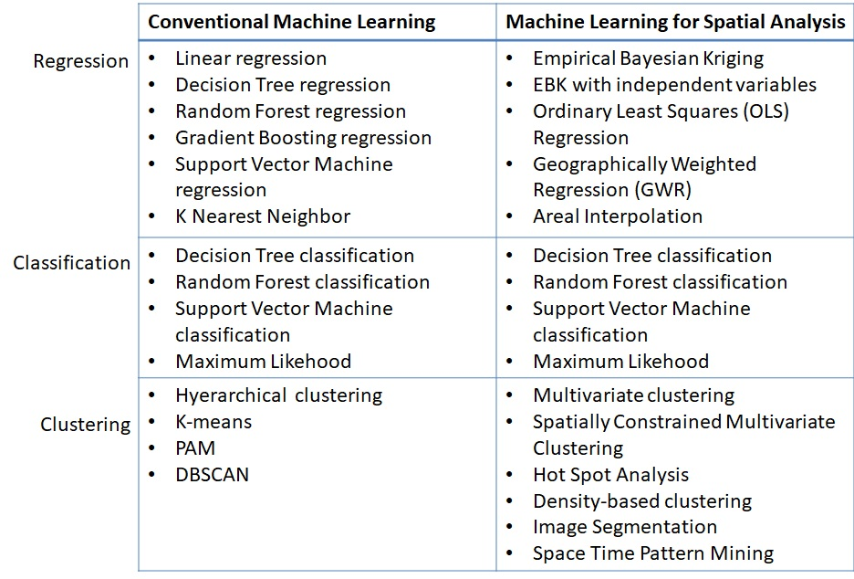
Machine Learning for Spatial Data Science
Analytics Vidhya, https://www.analyticsvidhya.com/blog/2021/03/introducing-machine-learning-for-spatial-data-analysis/

Slide 22
Ethics and Machine Learning
The implications of machine learning and AI are significant for cities and the built environment. Machine learning and AI bring up a variety of ethical questions around issues such as data quality, privacy, bias and discrimination and transparency.
UK Statistics Authority, https://uksa.statisticsauthority.gov.uk/publication/ethical-considerations-in-the-use-of-machine-learning-for-research-and-statistics/

Slide 23
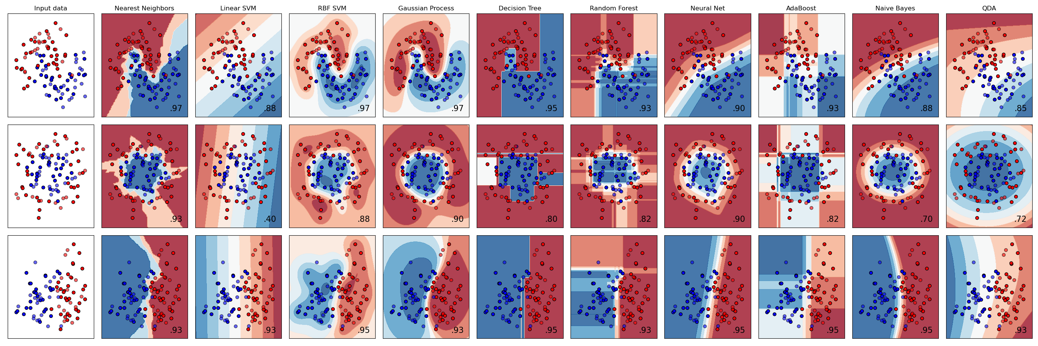
Machine Learning with Python
Python has a range of packages for performing machine learning: - scikit-learn
- PySAL
- Pandas
- NumPy
- SciPy
- TensorFlow
- Keras
- PyTorch
scikit-learn, https://scikit-learn.org

Slide 24



https://scikit-learn.org/stable/
https://pysal.org/
A Python package for performing machine learning
A Python package for spatial analysis
https://www.tensorflow.org
An open source platform for machine learning

Slide 25
Python, Git and Jupyter Notebooks
If Jupyter is not already installed, download Anaconda (https://www.anaconda.com/) and install Jupyter Notebook or you can install it from the Terminal app with pip:
pip install notebook
Set the working directory from the Terminal app or in the Terminal in Jupyter Notebook.
Clone the workshop repo from Github using Git:
git clone https://github.com/lbuk/UD_Intro_SDSML2022
Launch Jupyter Notebook:
jupyter notebook
Select the 03_machine_learning folder, the notebook folder and the 03_notebook.ipynb file

Slide 26
Programming Collective Intelligence book: https://www.oreilly.com/library/view/programming-collective-intelligence/9780596529321/ Introduction to Machine Learning with Python book: https://www.oreilly.com/library/view/introduction-to-machine/9781449369880/ Machine Learning with Python Cookbook book: https://www.amazon.co.uk/Machine-Learning-Python-Cookbook-Chris/dp/1491989386 Machine Learning and the City - Applications in Architecture and Urban Design book: https://www.wiley.com/en-gb/Machine+Learning+and+the+City:+Applications+in+Architecture+and+Urban+Design-p-9781119749639 UK Statistics Authority’s guide to Ethical Considerations in Machine Learning for Research and Statistics: https://uksa.statisticsauthority.gov.uk/publication/ethical-considerations-in-the-use-of-machine-learning-for-research-and-statistics/ Geographic Data Science with Python book: https://geographicdata.science/book/intro.html Geographic Data Science with PySAL and the pydata stack: http://darribas.org/gds_scipy16/ Geoprocessing with Python book: https://livebook.manning.com/book/geoprocessing-with-python Python Foundation for Spatial Analysis: https://courses.spatialthoughts.com/python-foundation.html Introduction to Python for Geographic Data Analysis book: https://pythongis.org/
Resources

